Slide 1
ITCS 3134
KWOK YIN HANG
E12 - Connected Component Labeling

Slide 2
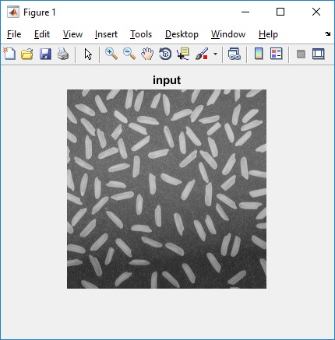
input image

Slide 3
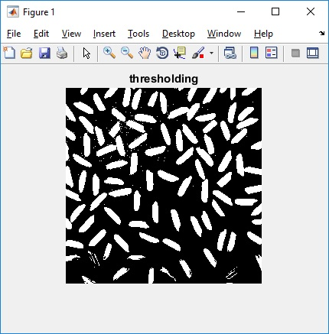
Otsu thresholded output (binary image)

Slide 4
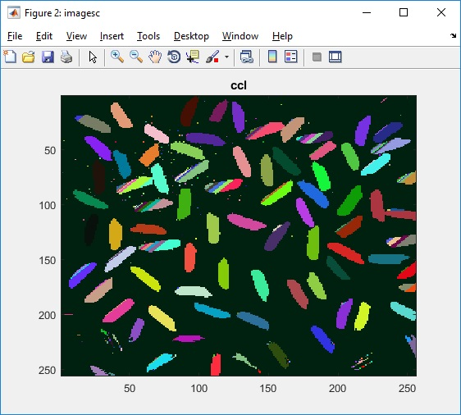
connected component labeling results. Feel free to use teh code snippet below for randomizing color

Slide 5
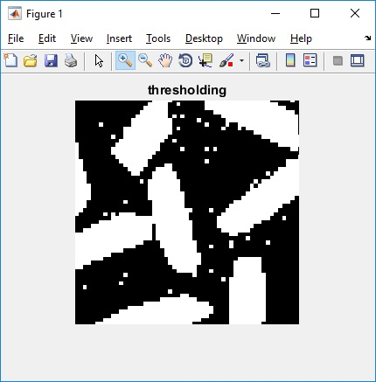
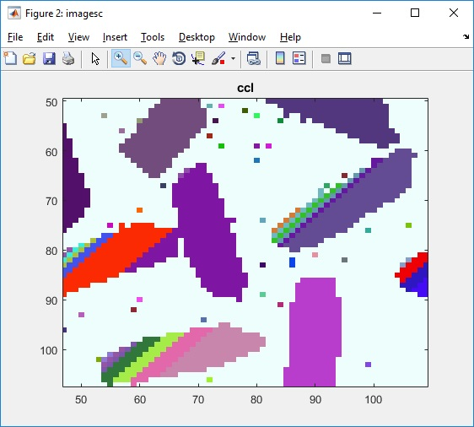
compare the results before and after small region removal

